Slide 1

UNIVERSITY COLLEGE OF ENGINEERING
(BIT CAMPUS) TIRUCHIRAPPALLI
ML based strabismus risk assessment system
PRESENTED BY GUIDED BY
Abinaya K – 810022104071 Mr.M. Krishna Kumar
Hansini Chella A - 810022104107 Department of Information Technology

Slide 2
AIM :
To develop an ML-based system for early detection of strabismus using eye images.
To integrate image analysis and clinical questionnaire data for accurate risk assessment.
To provide a user-friendly web application for public awareness and accessibility.
To generate risk levels (Low / Moderate / High) along with explanation and recommendation.
To reduce dependency on manual diagnosis and enable early screening.

Slide 3
OBJECTIVE :
To design and develop an automated image-based strabismus detection system using CNN.
To implement transfer learning (MobileNetV2) for efficient feature extraction.
To develop a Machine Learning model (Logistic Regression) for analyzing structured questionnaire data.
To combine deep learning and machine learning outputs using score-level weighted fusion.
To classify risk levels into Low, Moderate, and High categories.
To build a real-time web-based interface for user interaction and result visualization.
To ensure computational efficiency suitable for academic and low-resource environments.

Slide 4
Literature Survey:
S.NO | TITLE | AUTHORS NAME | YEAR / PUBLISHER | METHOD / TECHNOLOGY | LIMITATIONS | FUTURE WORK
1 | Mobile Strabismus Automatic Detection Method Combining Alternating Cover Test and Deep Learning | Tianlun Wang, Mengyi Jin, Changsheng Xu, Zuguo Liu, Xu Wang | 2024, IEEE | Combines Alternating Cover Test with Deep Learning for automatic strabismus detection using mobile devices | Depends on controlled environment; limited dataset size | Improve real-time detection and expand dataset for better accuracy
2 | Automated Strabismus Detection and Classification using Deep Learning Analysis of Facial Images | Mahsa Yarkheir, Motahhareh Sadeghi, Hamed Azarnoush, Mohammad Reza Akbari, Elias Khalili | 2025, Scientific Reports (Nature) | Uses Deep Learning (CNN) to analyze facial images and classify strabismus | Requires large labeled dataset; performance depends on image quality | Use larger datasets and improve robustness for real-world conditions
3 | Comparative Study of Deep Learning Models for Strabismus Diagnosing Using Facial Images | (Springer Authors) | 2026, Springer | مقارنة multiple DL models (CNN, MobileNet, etc.) for best performance in strabismus detection | Model performance varies across datasets | Optimize model selection and improve generalization

Slide 5
4 | Artificial Intelligence-Powered System for Detecting, Diagnosing, and Rehabilitating Strabismus Disorder | Alaa Daher, Mohammad Ayache, Amira J. Zaylaa, M. Zuhair Abo Hadba, Yousef Aycha | 2023, IEEE | AI-based system integrating detection, diagnosis, and rehabilitation | Complex system design; requires multiple modules | Enhance automation and integrate real-time monitoring
5 | AI-Enabled Automated Strabismus Detection and Corneal Deviation Analysis Using Image Processing Techniques | (Springer Authors) | 2026, Springer | Uses image processing + AI to analyze corneal deviation and eye alignment | Limited real-world validation | Improve clinical validation and dataset diversity
6 | Orthoptic Assessment of a Patient with Strabismus | (Springer Authors) | 2024, Springer | Clinical assessment techniques like cover test, eye alignment analysis | No automation or AI involvement | Combine clinical methods with AI-based systems

Slide 6
EXISTING SYSTEM:
Existing systems rely on manual image upload without intelligent analysis
No integration of clinical data with image-based detection
Most systems provide only binary output (Yes/No) without risk levels
Lack of real-time camera support
Limited user-friendly interface for public usage
No proper explanation or recommendation in results

Slide 7
PROPOSED SYSTEM :
Developed an AI-based web system for strabismus detection
Supports image upload and real-time camera capture
Uses MobileNetV2 (Deep Learning model) for classification
Integrates clinical questionnaire data for better accuracy
Provides risk levels (Low / Moderate / High)
Displays clear result with recommendation
Simple and accessible for public use

Slide 8
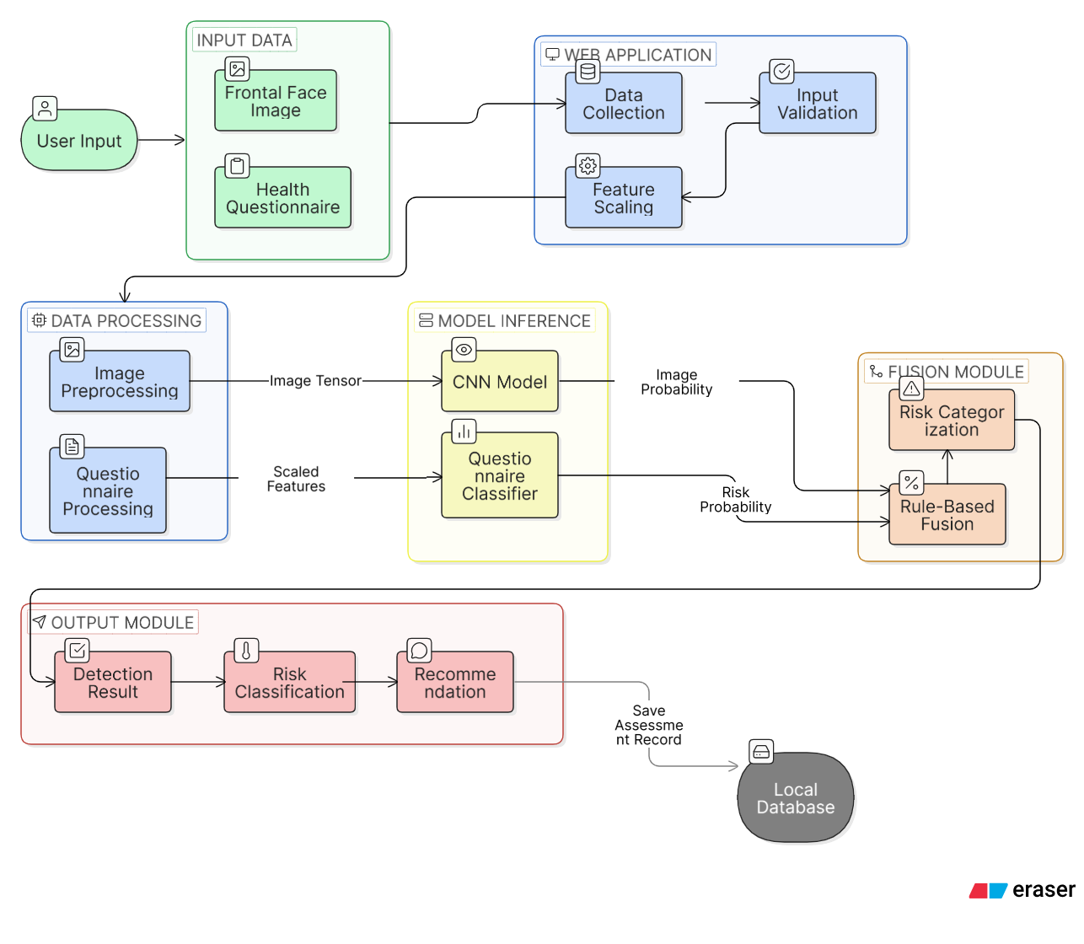
ARCHITECTURE :

Slide 9
METHODS AND TECHNIQUES :
I1.1mage Preprocessing :
Resize, normalize, and detect face & eye regions
2.Feature Extraction :
Extract features using MobileNetV2 (Transfer Learning)
3.Classification :
Classify images as Strabismus / Normal using CNN
4.Questionnaire Processing :
Encode and scale clinical input data
5.Risk Prediction :
Predict risk probability using Logistic Regression
6.Fusion Technique :
Combine image and questionnaire results using rule based fusion
7.Final Output :
Generate Low / Moderate / High risk classification

Slide 10
SOFTWARE REQUIREMENTS :
HARDWARE REQUIREMENTS :
Operating System: Windows
Programming Language: Python 3.10
Libraries & Tools:
▪ OpenCV – For image preprocessing
▪ TensorFlow (Keras) – For deep learning (MobileNetV2)
▪ scikit-learn – For Logistic Regression
▪ NumPy & Pandas – For data handling
Development Tool: VS Code
Version Control: GitHub
Processor: Intel i5 or higher
RAM: Minimum 8 GB (16 GB recommended)
Storage: Minimum 20 GB free space
Web Camera (Optional): For testing real-time images

Slide 11
IMAGE DATASET DESCRIPTION
QUESTIONNAIRE DATASET DESCRIPTION
Source: Kaggle eye alignment dataset + Real-time collected eye images
Classes:
• Normal Eyes
• Strabismus (Crossed Eyes)
Preprocessing Steps:
• Face detection
• Both-eye region cropping
• Resize to 224 × 224 pixels
• Pixel normalization (0–1 scaling)
• Removal of blurred and single-eye images
Dataset Split:
• 70% – Training
• 20% – Validation
• 10% – Testing
Data Augmentation:
• Horizontal flipping
• Rotation
• Brightness adjustment
• Zoom variation
Purpose:
To train MobileNetV2-based CNN for automated strabismus detection.
Dataset Type: Structured CSV dataset
Input Features:
• Age
• Onset Type (Sudden / Gradual)
• Double Vision
• Headache
• Diabetes
• Thyroid Condition
Target Variable:
• Risk Level (Low / Moderate / High)
Preprocessing:
• Label encoding
• Feature scaling (StandardScaler)
• Train-test split
Model Used:
Logistic Regression
Purpose:
To assess clinical risk factors contributing to strabismus.

Slide 12
Image Classification Module :
PSEUDOCODE :
CLASSIFICATION FORMULA & PROBABILITY CALCULATION
START
Load image dataset (train & test)
Preprocess images:
Resize to 224×224
Normalize pixel values (0–1)
Apply data augmentation (training data)
Load MobileNetV2 (pretrained)
Freeze base layers
Add custom layers:
GlobalAveragePooling
Dense (ReLU)
Dropout
Output layer (Sigmoid)
Compile model:
Loss → Binary Crossentropy
Optimizer → Adam
Train model:
Forward pass
Compute loss
Backpropagation
Update weights
Validate model and save
END
🔹 Linear Transformation
z=w⋅x+bz = w \cdot x + bz=w⋅x+b xxx = extracted features
www = weights
bbb = bias
🔹 Sigmoid Function (Probability)
P=11+e−zP = \frac{1}{1 + e^{-z}}P=1+e−z1​ 👉 Output range: 0 to 1 (probability)
P≈1P \approx 1P≈1 → Strabismus
P≈0P \approx 0P≈0 → Normal
🔹 Loss Function
L=−[ylog⁡(p)+(1−y)log⁡(1−p)]L = -[y \log(p) + (1-y)\log(1-p)]L=−[ylog(p)+(1−y)log(1−p)]
🔹 Final Decision Rule
If P ≥ 0.5 → Strabismus
Else → Normal

Slide 13
Questionnaire-Based Risk Module:
PSEUDOCODE :
RISK PROBABILITY & CLASSIFICATION FORMULA
START
Load dataset (questionnaire data)
Check class distribution
Split data:
X → input features
y → Risk label
Perform train-test split (80% train, 20% test)
Apply feature scaling:
StandardScaler
Train Logistic Regression model:
Fit model on training data
Predict on test data:
y_pred = model.predict(X_test)
Evaluate model:
Accuracy
Confusion Matrix
Classification Report
Visualize performance (graphs)
Save model and scaler
END
🔹 Logistic Regression Probability
P=11+e−zP = \frac{1}{1 + e^{-z}}P=1+e−z1​
🔹 Linear Combination
z=w1x1+w2x2+⋯+wnxn+bz = w_1x_1 + w_2x_2 + \dots + w_nx_n + bz=w1​x1​+w2​x2​+⋯+wn​xn​+b xxx → input features (questionnaire data)
www → weights
bbb → bias
🔹 Risk Classification (3 Categories)
Risk={Low,P<0.33Moderate,0.33≤P<0.66High,P≥0.66\text{Risk} = \begin{cases} \text{Low}, & P < 0.33 \\ \text{Moderate}, & 0.33 \le P < 0.66 \\ \text{High}, & P \ge 0.66 \end{cases}Risk=⎩⎨⎧​Low,Moderate,High,​P<0.330.33≤P<0.66P≥0.66​

Slide 14
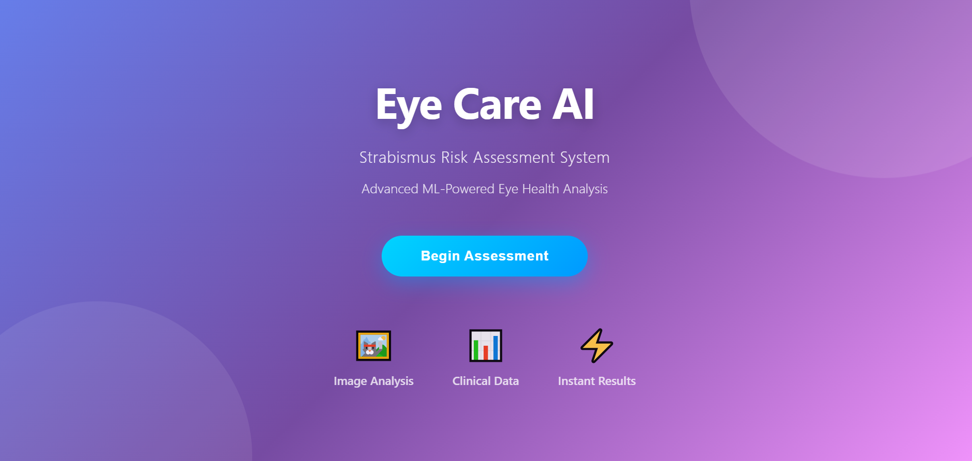
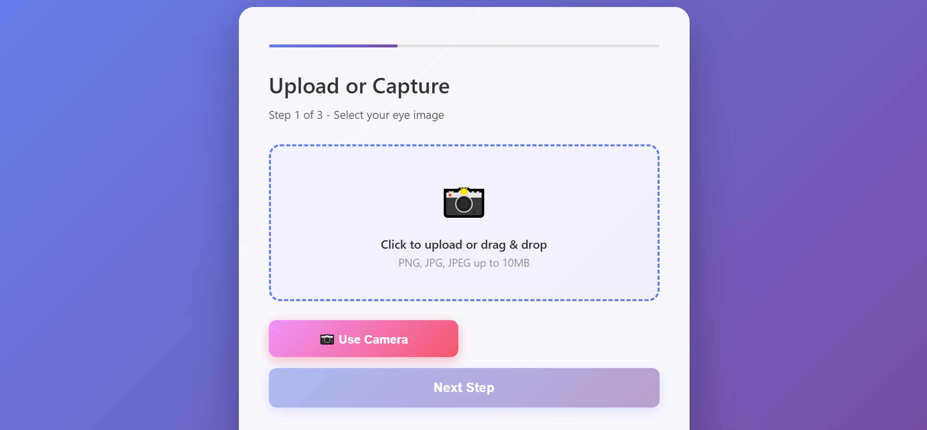
OUTPUT SCREENS :

Slide 15
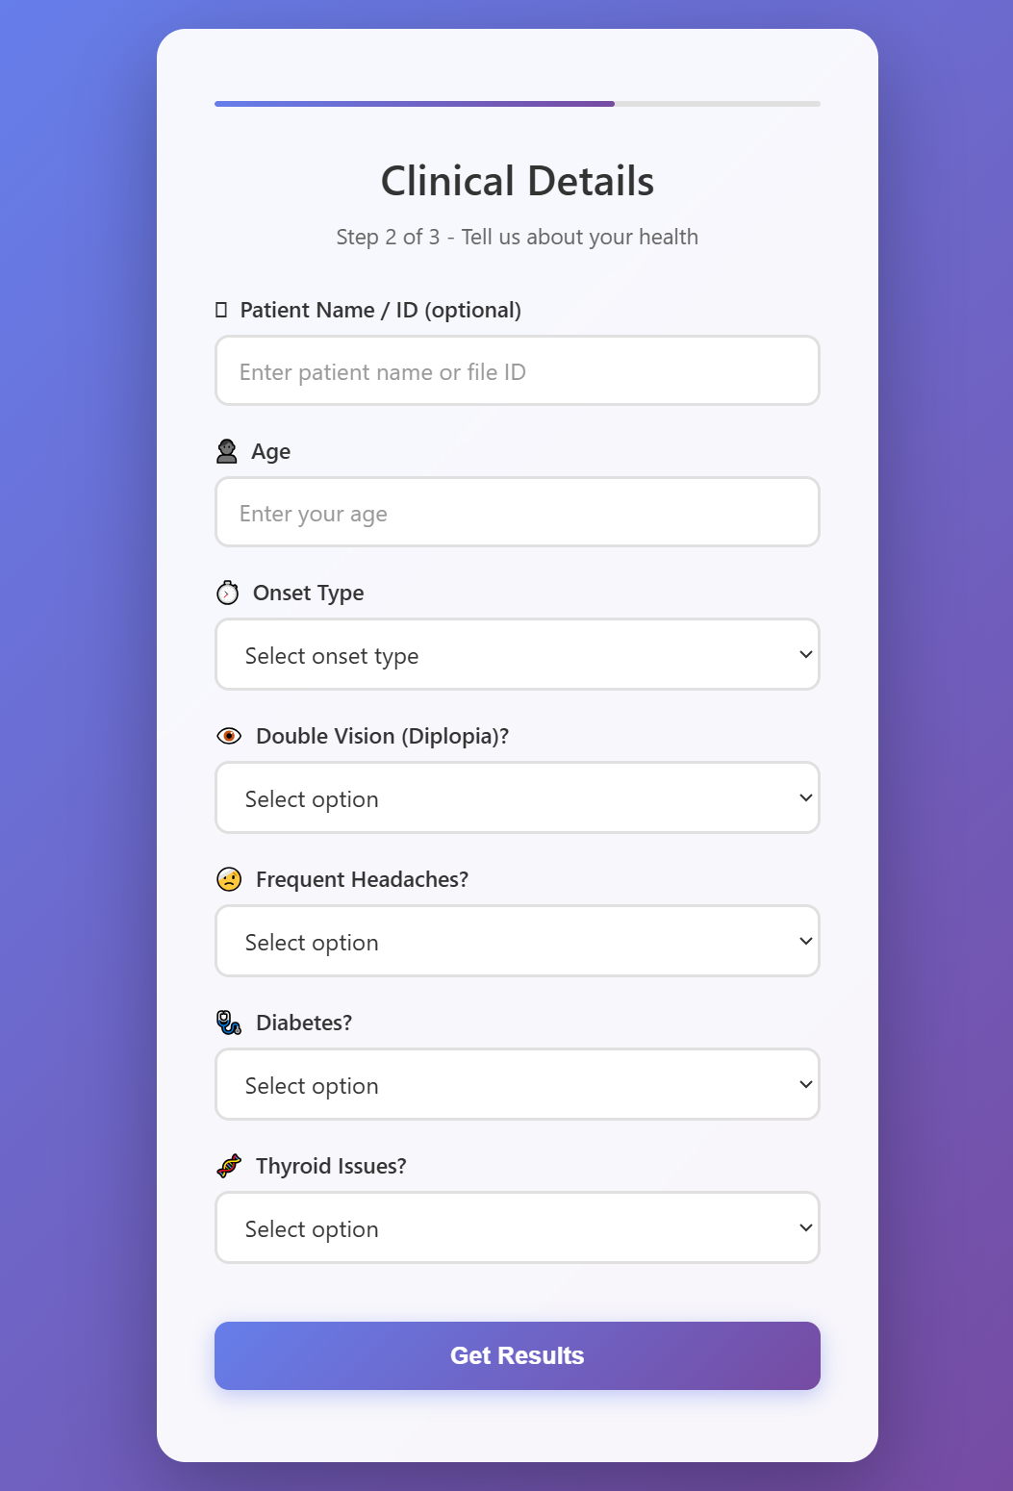
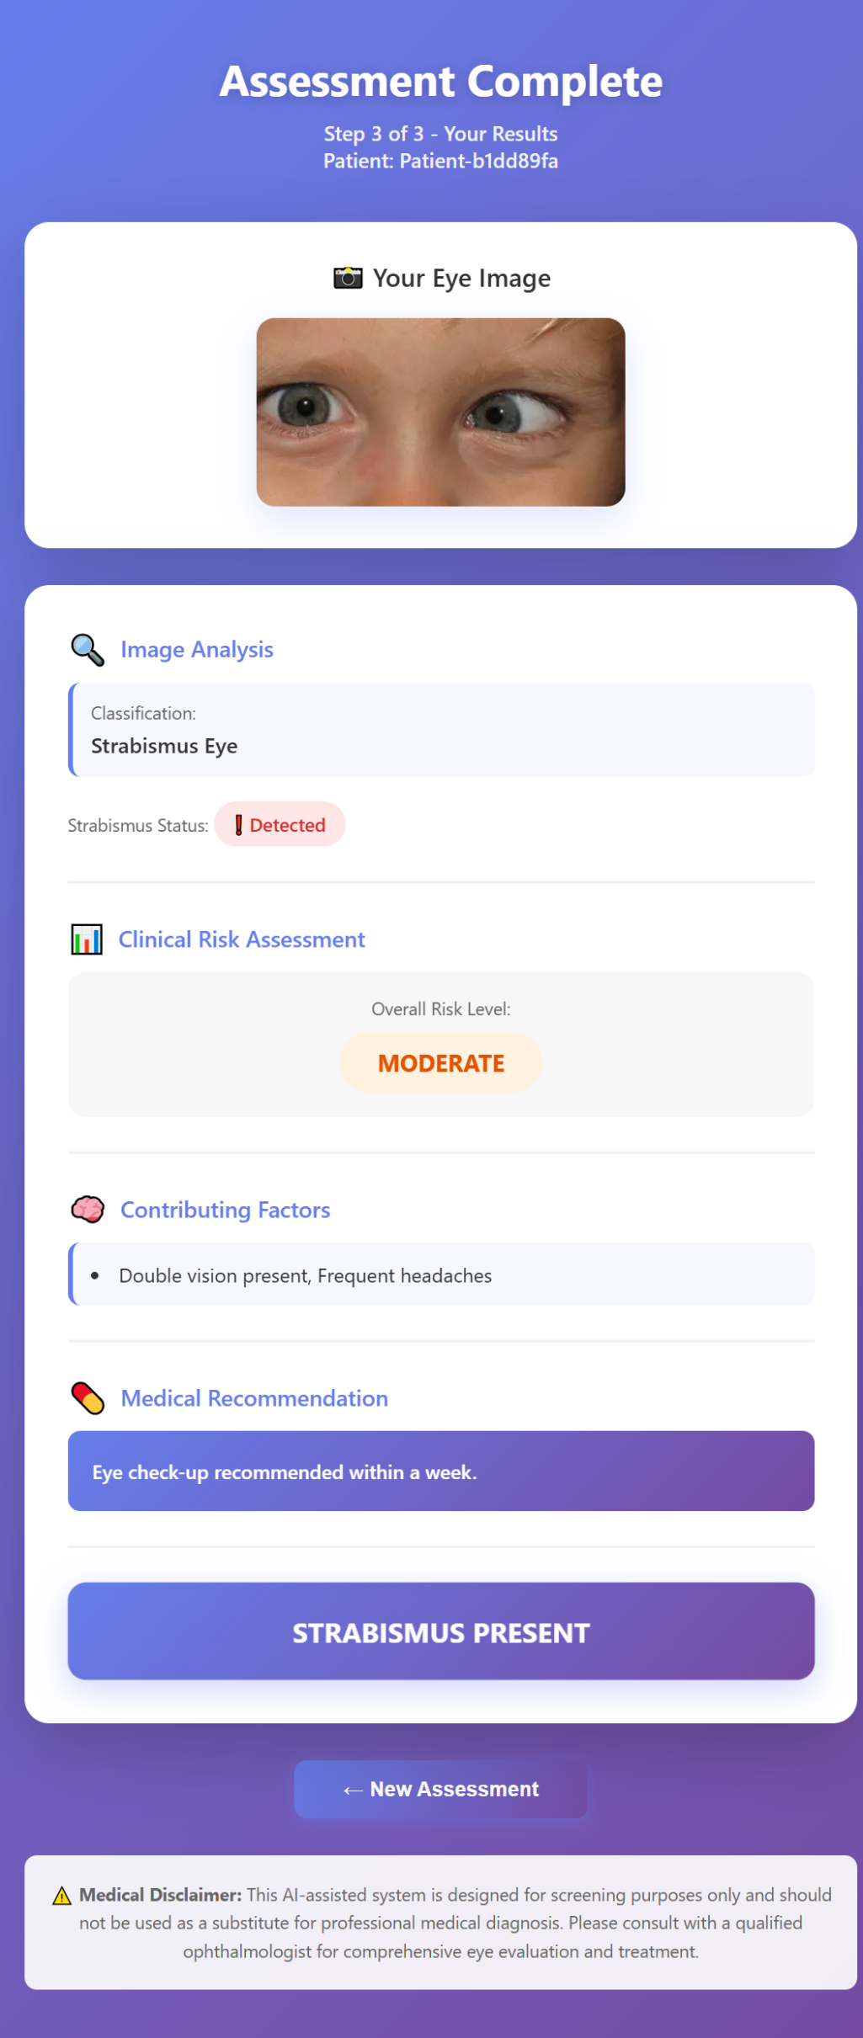

Slide 16
CONCLUSION :
This project presents a hybrid Machine Learning and Deep Learning based system for automated detection and risk assessment of Strabismus using facial image analysis and structured clinical inputs. By integrating a Convolutional Neural Network (MobileNetV2) for eye alignment detection with a Logistic Regression model for symptom-based risk analysis, the system provides reliable and efficient screening support. The use of score-level weighted fusion enhances prediction accuracy by combining visual and clinical features. The proposed approach is computationally efficient, suitable for real-time applications, and can assist in early identification of strabismus, thereby enabling timely medical consultation and reducing dependency on manual examination.

Slide 17
FUTURE WORK :
1. Strabismus Type Classification :
Extend the system to classify different types of strabismus such as Esotropia, Exotropia, Hypertropia, and Hypotropia instead of only detecting presence.
2. Mobile Application Development :
Develop a mobile app to enable real-time eye analysis using smartphone camera for easy public access.
3.Improved Accuracy with Advanced Models :
Use advanced deep learning models and larger datasets to improve precision, robustness, and real-world performance.

Slide 18
Wang, T., et al., “Mobile Strabismus Automatic Detection Method Combining Alternating Cover Test and Deep Learning,” IEEE, 2024
.Yarkheir, M., et al., “Automated Strabismus Detection and Classification using Deep Learning Analysis of Facial Images,” Scientific Reports (Nature), 2025.
Garg, S., et al., “StrabNet-CQ: Deep Learning Framework for Strabismus Detection and Quantification,” Springer, 2025.
Santos, R.D., et al., “Deep Learning Approach using Cover Test Video Analysis for Strabismus Detection,” Expert Systems with Applications, 2025.
Yang, Z., et al., “Systematic Review and Meta-analysis of AI for Strabismus Detection,” 2025.
Daher, A., et al., “AI-Powered System for Detecting, Diagnosing and Rehabilitating Strabismus,” IEEE, 2023.
Lee, M., et al., “AI-Assisted Strabismus Diagnosis using Eye Tracking and Machine Learning,” MDPI Diagnostics, 2026.
Chawuthai, R., et al., “Strabismus Screening using Mobile Phone Images and Transformer Models,” Nature Scientific Reports, 2026.
Celik, C., & Yücedağ, İ., “Deep Learning in Retinal Image Processing: A Review,” Springer, 2026.
Lee, J., et al., “Deep Learning-Based Eye Region Cropping for Strabismus Detection,” Journal of Medical Internet Research, 2025.
REFERENCES :

